Slide 1

Sprocket Central Pty Ltd
Data analytics approach
[Khushboo Gupta]

Slide 2
Agenda
Introduction
Data Exploration
Model Development
Interpretation

Slide 3
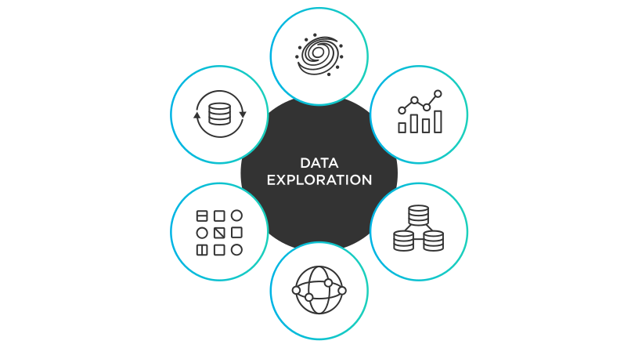
Introduction
Let’s Learn About the Dataset & Our Problem
We have Four Datasets namely Transactions, Customer Demographic, Customer Address & New Customer List.
We have to find which customer should we target based on our existing customer database.
We will do our research in 3 phases: Data Exploration, Model Development & Interpretation.

Slide 4
Data Exploration
Take insights from the dataset through its statistically and visual aspects and recognize how the factors are affecting our marketing strategy
Data Exploration is the first step in data analysis involving the use of visualization tools & statistical techniques to reveal the dataset characteristics.
In our given datasets, we explore the data on different aspects visually & statistically. We clean the dataset & make it more accurate to have the better recommendations to add on our new customers.
We visualize which factor is affecting more & how our customers engagement to have a better understanding. Accordingly we can work on that.

Slide 5
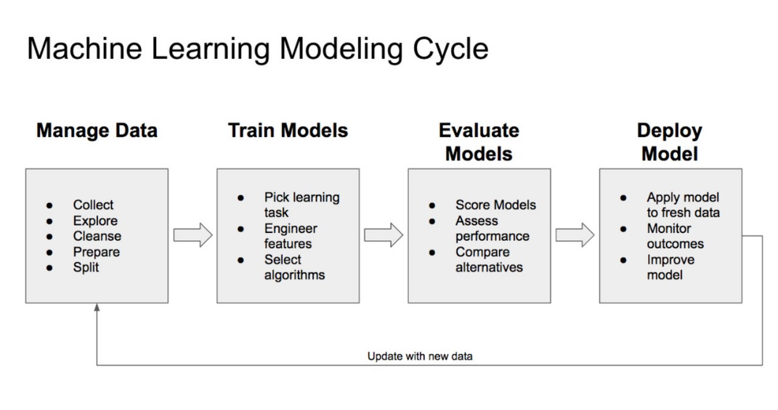
Model Development
Developing the Model using the best algorithm for the best satisfactory results at the end
After visualize and cleaning the datasets, we will move forward towards the model development. In this, we will train our model with this more accurate and considerate datasets with a preferable ratio of 20% to 80% between the training & testing.
Afterwards, we choose our best model until the results are satisfactory by using the different algorithms.

Slide 6
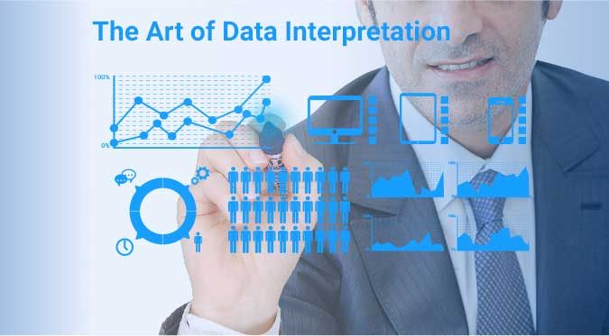
Interpretation
Interpret the insights of the datasets to have a better understanding on improvising the marketing strategy
After successfully prepared our model, now we are ready for the final insights from our datasets. Using our model recommendations, we can finally suggest you on the best marketing strategy.
We will provide a full report on the factors and their affects on your customers and how you can improvise your strategy to work on specific age group, area and other aspects.

Slide 7
Appendix

Slide 8
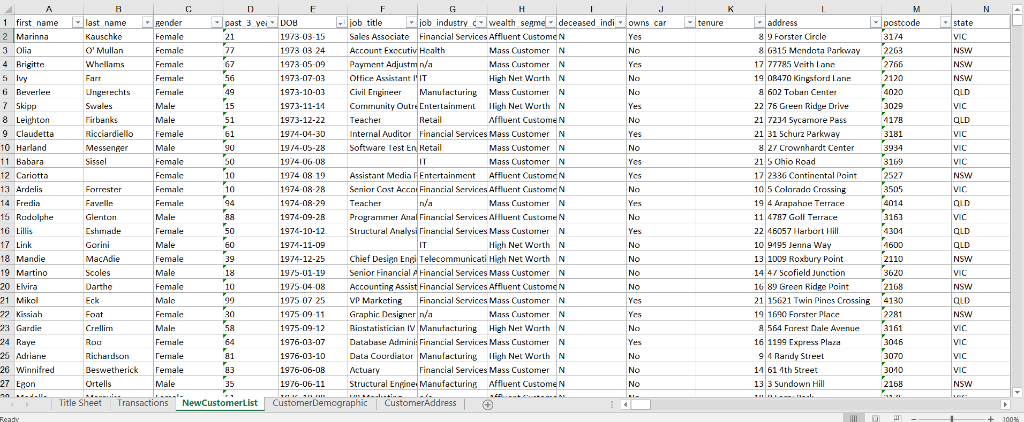
Appendix
OUR PREDICTING DATASET

